Slide 1
Bayes & Decision Tree Classifiers

Slide 2
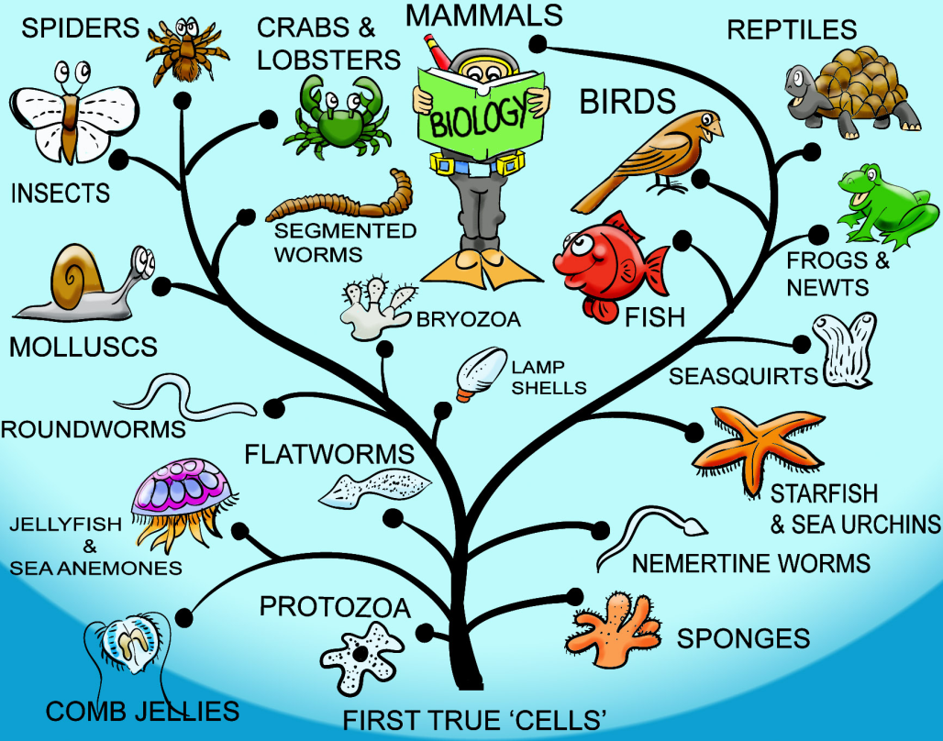

Overview
Naïve Bayes Classifier
Decision Tree Model
Thomas Bayes
Evolution Tree
Notes:
托马斯·贝叶斯（Thomas Bayes，1702-1761），18世纪英国神学家、数学家、数理统计学家和哲学家，概率论理论创始人，贝叶斯统计的创立者，“归纳地”运用数学概率，“从特殊推论一般、从样本推论全体”的第一人。
贝叶斯在数学方面主要研究概率论。他首先将归纳推理法用于概率论基础理论，并创立了贝叶斯统计理论，对于统计决策函数、统计推断、统计的估算等做出了贡献。1763年发表了这方面的论著，对于现代概率论和数理统计都有很重要的作用。贝叶斯的另一著作《机会的学说概论》发表于1758年.贝叶斯所采用的许多术语被沿用至今。
他对统计推理的主要贡献是使用了"逆概率"这个概念，并把它作为一种普遍的推理方法提出来。贝叶斯定理原本是概率论中的一个定理，这一定理可用一个数学公式来表达，这个公式就是著名的贝叶斯公式。
1763年由Richard Price整理发表了贝叶斯的成果《An Essay towards solving a Problem in the Doctrine of Chances》，提出贝叶斯公式。
树状结构，层次性

Slide 3

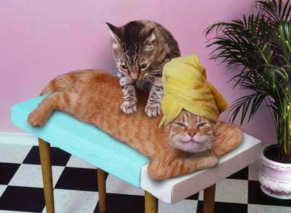
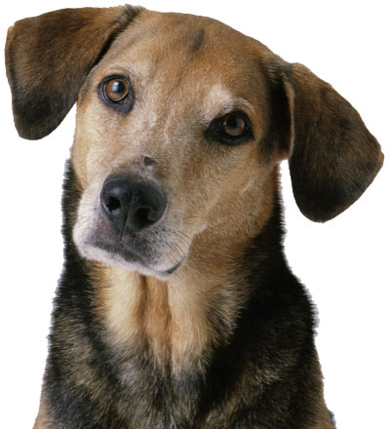
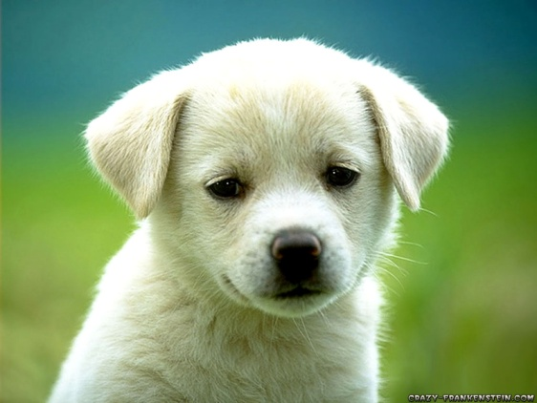
Classification

Slide 4
Definition
Classification is one of the fundamental skills for survival.
Food vs. Predator
A kind of supervised learning
Techniques for deducing a function from data
<Input, Output>
Input: a vector of features
Output: a Boolean value (binary classification) or integer (multiclass)
“Supervised” means:
A teacher or oracle is needed to label each data sample.
We will talk about unsupervised learning later.
Notes:
predator英[ˈpredətə(r)]美[ˈpredətər]
n.捕食性动物; 实行弱肉强食的人(或机构); 剥削者; 掠夺者;
deduce英[dɪˈdjuːs]美[dɪˈduːs]
v.推论; 推断; 演绎;
oracle英[ˈɒrəkl]美[ˈɔːrəkl]
n.(古希腊的)神示所; (传达神谕的)牧师，女祭司; (古希腊常有隐含意义的)神谕，神示; 能提供宝贵信息的人(或书); 权威; 智囊;

Slide 5
Classifiers
{boy, girl}
Weight
Peter
Sam
Jack
Z=f(x,y)
Jane
Tom
Lisa
Helen
Mary
Height
Weight
Height
Notes:
不会百分之百正确
训练过程，学习过程
超参数，参数，训练
新样本，数据集里面没有的
属性，维度，特征，都是同义词

Slide 6
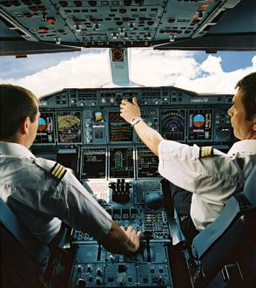
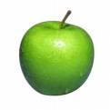
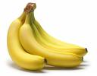
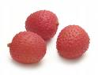
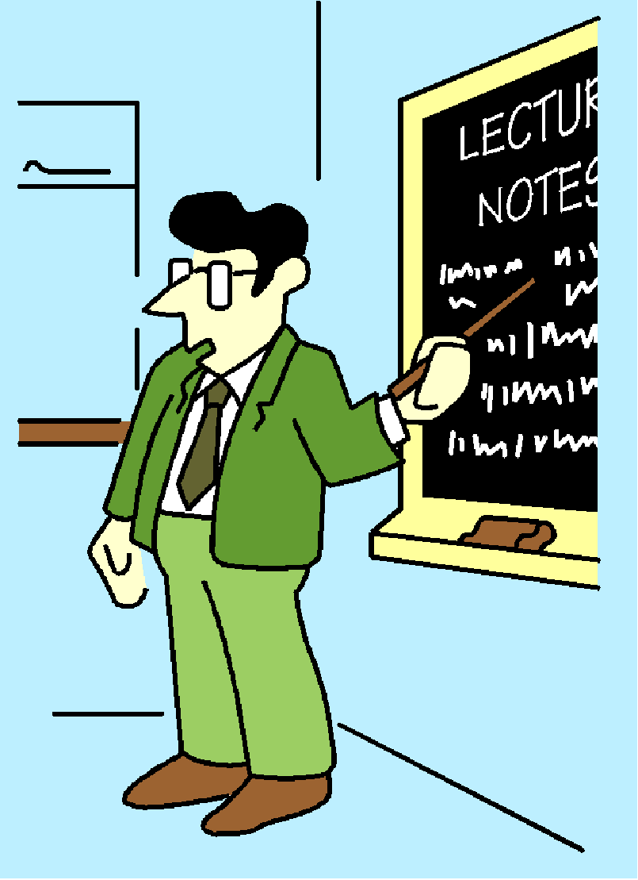
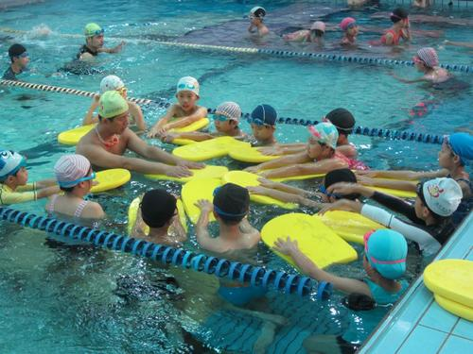
Training a Classifier
Learning
Notes:
人类的学习过程

Slide 7
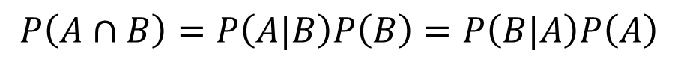
Bayes Theorem
A
B
$$P\left(A∪B\right)=P\left(A\right)+P\left(B\right)−P\left(A∩B\right)$$
$$P\left(A∩B\right)=P\left(A|B\right)P\left(B\right)=P\left(B|A\right)P\left(A\right)$$
Likelihood of evidence B if A is true
Prior probability
Posterior probability of A given the evidence B
Prior probability that evidence B is true

Slide 8
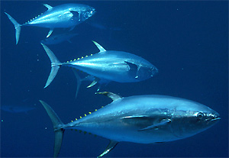
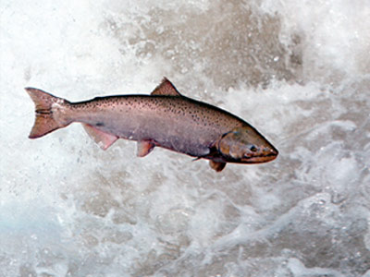
Fish Example
Salmon vs. Tuna
Grab a fish at random.
P(ω₁)=P(ω₂)
P(ω₁)>P(ω₂)
Additional information
Notes:
tuna英[ˈtjuːnə]美[ˈtuːnə]
n.金枪鱼;
条件，颜色

Slide 9

Shooting Example
Probability of Kill
P(A): 0.6
P(B): 0.5
The target is killed with:
One shoot from A
One shoot from B
What is the probability that it is shot down by A?
C: The target is killed.
Notes:
目标被击中
A B可能同时命中
B 比1/4大

Slide 10

Cancel Example
ω₁: Cancer; ω₂: Normal
P(ω₁)=0.008; P(ω₂)=0.992
Lab Test Outcomes: + vs. –
P(+|ω₁)=0.98; P(-|ω₁)=0.02
P(+|ω₂)=0.03; P(-|ω₂)=0.97
Now someone has a positive test result…
Is he/she doomed?
Notes:
体检，化验，阳性，阴性
假阳性 漏检
doom英[duːm]美[duːm]
n.死亡; 毁灭; 厄运; 劫数;v.使…注定失败(或遭殃、死亡等);

Slide 11
Cancel Example
Notes:
阳性时，得癌症的概率
绝大多数人是正常的

Slide 12

Headache & Flu Example
H=“Having a headache”
F=“Coming down with flu”
P(H)=1/10; P(F)=1/40; P(H|F)=1/2
What does this mean?
One day you wake up with a headache …
Since 50% flu cases are associated with headaches …
I must have a 50-50 chance of coming down with flu!
Notes:
头疼 得流感

Slide 13
Headache & Flu Example
The truth is …
Flu
Headache
Notes:
头疼 得流感
和 得流感头疼 概率是不同的

Slide 14
Naïve Bayes Classifier
Conditionally Independent
MAP: Maximum A Posterior
Notes:
最大后验概率
属性，非常多的时候，很难处理
朴素贝叶斯
Likelihood of evidence 一般是已知的

Slide 15
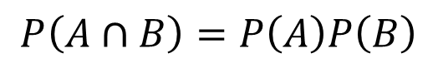
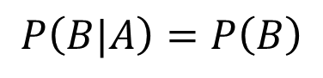
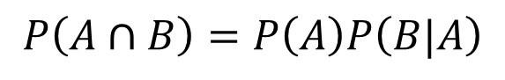
Independence
$$P\left(A∩B\right)=P\left(A\right)P\left(B|A\right)$$
$$P\left(B|A\right)=P\left(B\right)$$
$$P\left(A∩B\right)=P\left(A\right)P\left(B\right)$$
Conditionally Independent
Notes:
独立，和条件独立不同

Slide 16

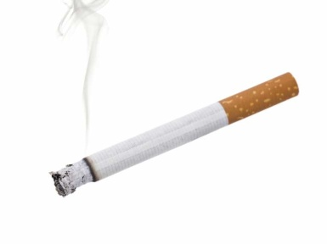
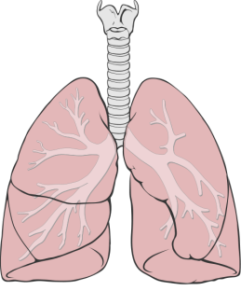
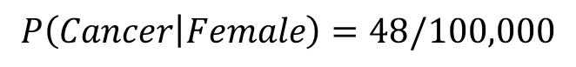
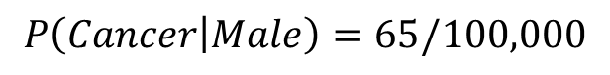
Conditional Independence
$$P\left(Cancer | Male\right)=65/100,000$$
$$P\left(Cancer | Female\right)=48/100,000$$
Are the two events Male/Female and Cancer independent?
Assume smoking is the sole contributing factor to cancer.
Conditionally Independent
$$P\left(Cancer | Male,Smoking\right)=P(Cancer|Smoking)$$
Notes:
健康节目，微信圈里，经常
男人更容易得肺癌？
吸烟是得肺癌的唯一因素
基因决定是否喜欢吸烟？

Slide 17
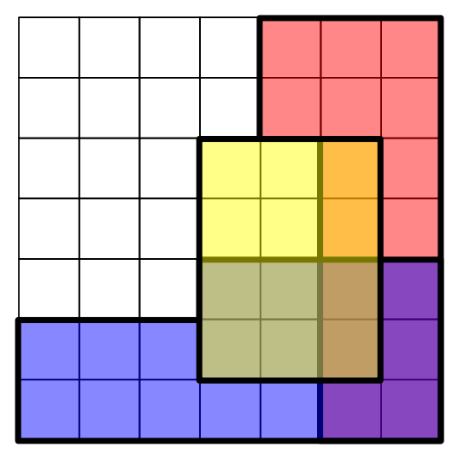
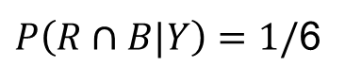
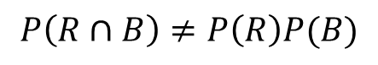
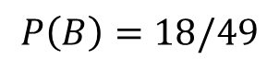
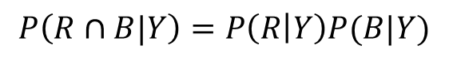
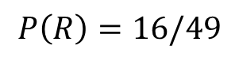
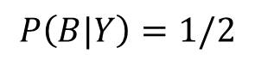
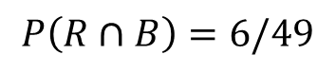
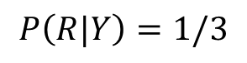
Conditional Independence
$$P\left(R∩B\right)=6/49$$
$$P\left(R\right)=16/49$$
$$P\left(B\right)=18/49$$
$$P\left(R∩B\right)≠P\left(R\right)P(B)$$
Not Independent
$P\left(R∩B|Y\right)=1/$6
$$P\left(R|Y\right)=1/3$$
$$P\left(B|Y\right)=1/2$$
$$P\left(R∩B|Y\right)=P\left(R | Y\right)P(B|Y)$$
Conditionally Independent

Slide 18
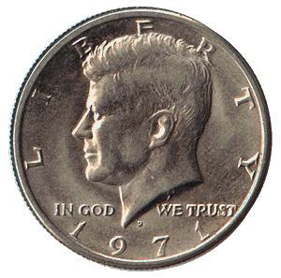


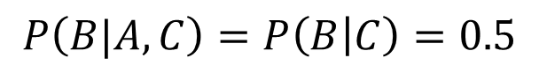
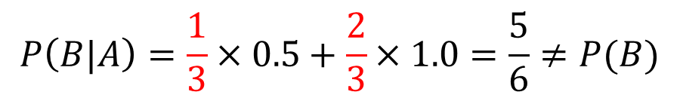
Conditional Independence
Two coins: fair vs. biased (two-headed)
Select one coin at random and toss twice.
A: First coin toss is head.
B: Second coin toss is head.
C: You selected the fair coin.
$$P\left(A\right)=P\left(B\right)=0.5×0.5+0.5×1.0=0.75$$
$P\left(C|A\right)=\frac{P\left(A | C\right)P(C)}{P\left(A | C\right)P(C)+P\left(A | ¬C\right)P(¬C)}$=$\frac{0.5×0.5}{0.5×0.5+1×0.5}=\frac{1}{3}$
$$P\left(B|A\right)=\frac{1}{3}×0.5+\frac{2}{3}×1.0=\frac{5}{6}≠P(B)$$
Not Independent
$$P\left(B|A,C\right)=P\left(B | C\right)=0.5$$
Conditionally Independent
Notes:
独立和条件独立
两枚硬币，二选一，
然后 抛两次
toss英 [tɒs] 美 [tɔːs] v.(轻轻或漫不经心地)扔，抛，掷;甩(头，以表示恼怒或不耐烦);(使)摇摆，挥动，颠簸n.掷硬币决定;向上甩头，猛仰头(尤指表示恼怒或不耐烦);(尤指比赛或游戏中)投掷

Slide 19
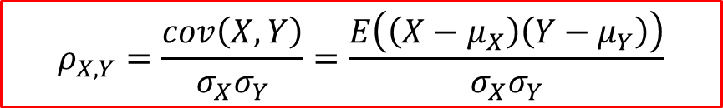
Independent ≠ Uncorrelated
$$ρ_{X,Y}=\frac{cov\left(X,Y\right)}{σ_{X}σ_{Y}}=\frac{E\left(\left(X−μ_{X}\right)\left(Y−μ_{Y}\right)\right)}{σ_{X}σ_{Y}}$$
Cov (X,Y)=0 → X and Y are uncorrelated.
However, Y is completely determined by X.
X | Y
1 | 1
0.5 | 0.25
0.2 | 0.04
0 | 0
-0.2 | 0.04
-0.5 | 0.25
-1 | 1
Notes:
独立 和 不相关

Slide 20
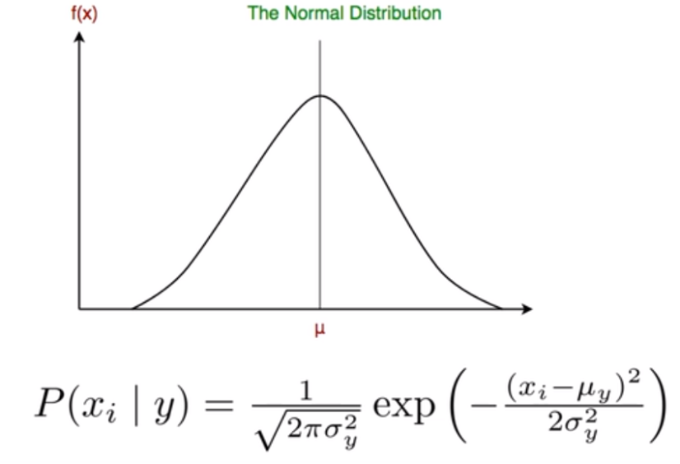
Estimating P(α_{j}|ω_{i})
α₁ | α₂ | α₃ | ω
 | + |  | ω₁
 |  |  | ω₂
 | - |  | ω₁
 | + |  | ω₁
 |  |  | ω₂
How about continuous variables?
Notes:
Likelihood of evidence

Slide 21
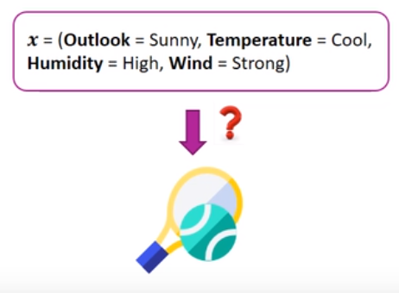
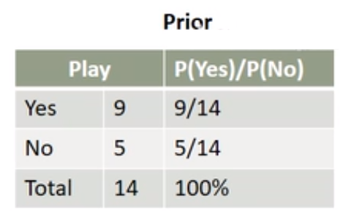
Tennis Example
Notes:
outlook英 [ˈaʊtlʊk] 美 [ˈaʊtlʊk] n.观点;见解;世界观;人生观;前景;可能性;景色;景致;景观
humidity英 [hjuːˈmɪdəti] 美 [hjuːˈmɪdəti] n.(空气中的)湿度;湿热;高温潮湿

Slide 22
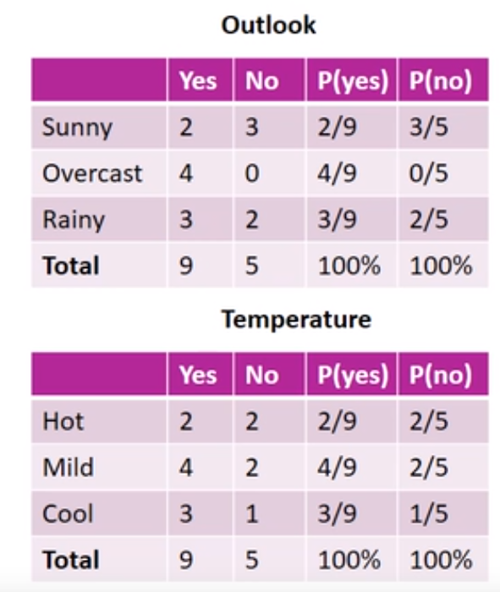
Tennis Example
Notes:
outlook英 [ˈaʊtlʊk] 美 [ˈaʊtlʊk] n.观点;见解;世界观;人生观;前景;可能性;景色;景致;景观
humidity英 [hjuːˈmɪdəti] 美 [hjuːˈmɪdəti] n.(空气中的)湿度;湿热;高温潮湿
overcast英 [ˌəʊvəˈkɑːst] 美 [ˌoʊvərˈkæst] adj.阴天的;多云的;阴暗的n.[气象学]阴;阴天;遮盖物(尤指云、雾等);郁闷;忧愁;沮丧;[采矿]风桥

Slide 23
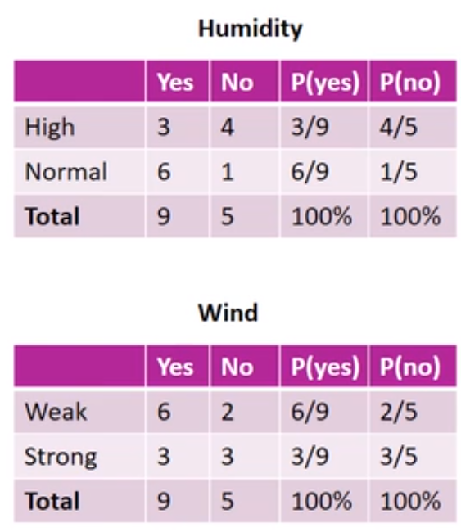
Tennis Example
Notes:
outlook英 [ˈaʊtlʊk] 美 [ˈaʊtlʊk] n.观点;见解;世界观;人生观;前景;可能性;景色;景致;景观
humidity英 [hjuːˈmɪdəti] 美 [hjuːˈmɪdəti] n.(空气中的)湿度;湿热;高温潮湿
overcast英[ˌəʊvəˈkɑːst]美[ˌoʊvərˈkæst] n.阴天; [气象学]阴; 遮盖物(尤指云、雾等); 郁闷; 忧愁; 沮丧; [采矿]风桥;adj.阴暗的; 阴天的; 多云的;

Slide 24
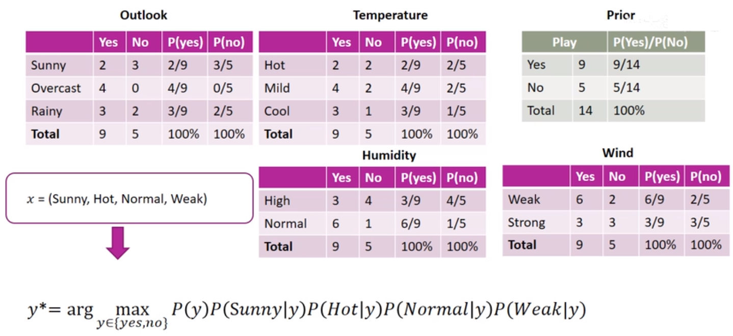
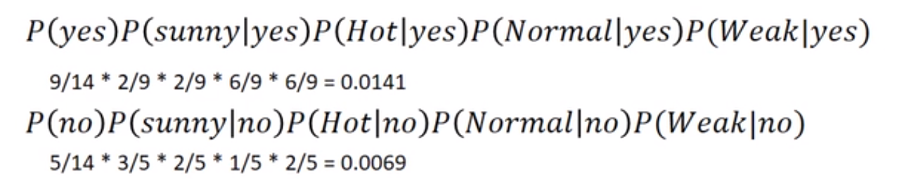
Tennis Example

Slide 25
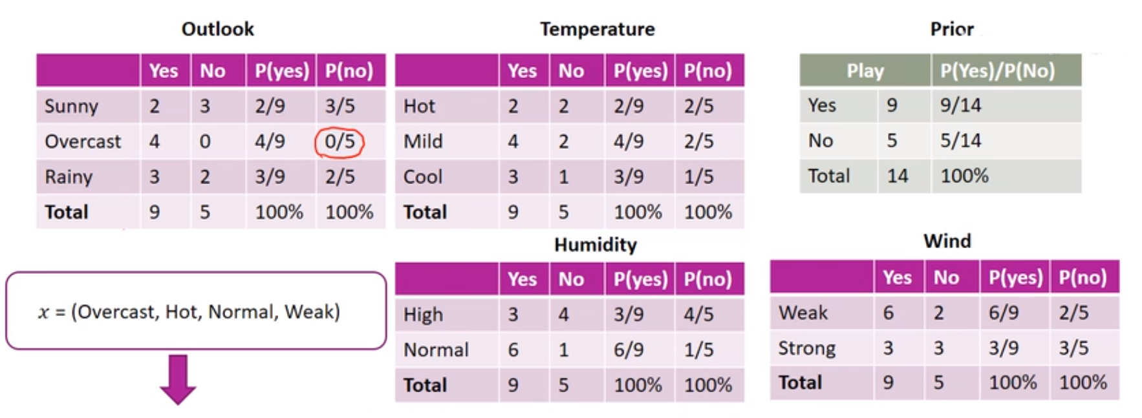
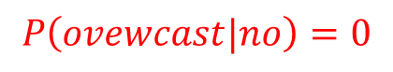
Tennis Example
$$P\left(ovewcast|no\right)=0$$

Slide 26
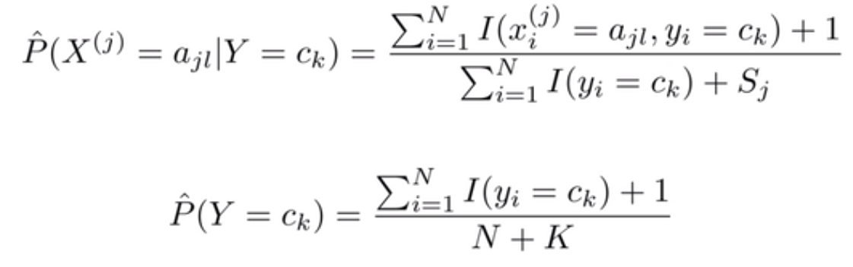
Laplace Smoothing
考虑：用极大似然估计可能会出现所要估计的概率为0的情况，这时会影响到后验概率的计算结果，使得分类产生偏差
解决这一类问题的方法是采用拉普拉斯平滑
Notes:
Sj 为第j个属性的所有取值个数
K 类别数，yes no ，为2

Slide 27
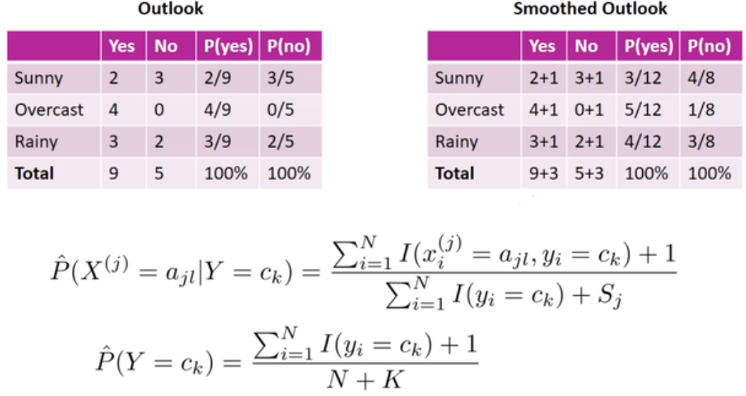
Laplace Smoothing

Slide 28
Text Classification Example
Interesting? Boring?
Politics? Entertainment? Sports?
Notes:
文本分类 新闻 推荐

Slide 29
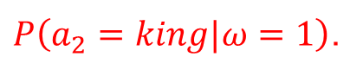
Text Representation
α₁ | α₂ | α₃ | α₄ | … | α_{n} | ω
Long | long | ago | there | … | king | 1
New | sanctions | will | be | … | Iran | 0
Hidden | Markov | models | are | … | method | 0
The | Federal | Court | today | … | investigate | 0
We need to estimate probabilities such as
$P\left(a_{2}=king|ω=1\right)$.
However, there are 2×n×|Vocabulary| terms in total. For n=100 and a
vocabulary of 50,000 distinct words, it adds up to 10 million terms!
Notes:
sanctions英[ˈsæŋkʃnz]美[ˈsæŋkʃnz]
n.制裁; (正式)许可，批准; 约束; 处罚;v.许可; 准许; 准予; 惩罚; 实施制裁;

Slide 30
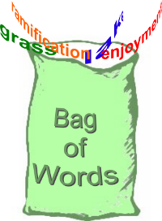
Text Representation
By only considering the probability of encountering a specific word instead of the specific word position, we can reduce the number of probabilities to be estimated.
We only count the frequency of each word.
Now, 2×50,000=100,000 terms need to be estimated.
n: the total number of word positions in all training samples whose target value is ω_{i}.
n_{k}: the number of times word V_{k} is found among these n positions.
Notes:
NBA 出现，一定是体育，具体位置无关
和词出现的频率有关
词袋模型

Slide 31
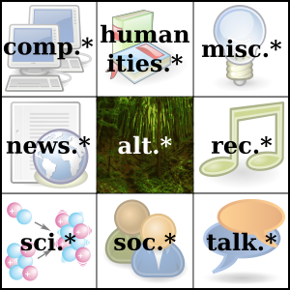
Case Study: Newsgroups
Classification
Joachims, 1996
20 newsgroups
20,000 documents
Random Guess: 5%
NB: 89%
Recommendation
Lang, 1995
NewsWeeder
User rated articles
Interesting vs. Uninteresting
Top 10% selected articles
16% vs. 59%
T. Joachims (1996). A probabilistic analysis of the Rocchio algorithm with TFIDF for text categorization, Computer Science Technical Report CMU-CS-96-118. Carnegie Mellon University.
K. Lang, “Newsweeder: Learning to filter netnews,” in Proc. 12th Int. Conf. Mach. Learn., 1995, pp. 331–339 .
Notes:
20个板块
推荐新闻文章
http://archive.ics.uci.edu/ml/datasets/Twenty+Newsgroups
Twenty Newsgroups Data Set Download: Data Folder, Data Set Description

Slide 32

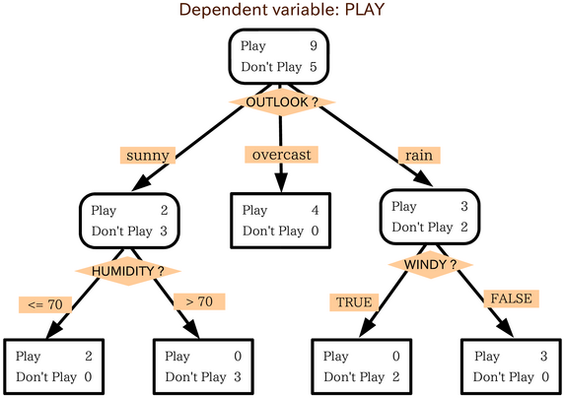


Decision Making
Notes:
做决策
性价比最高的
打网球
每个节点，有个属性，做判断
明晰，符合人类思维的分类器

Slide 33
A Survey Dataset
Given the data collected from a promotion activity.
Could be tens of thousands of such records.
Can we find any interesting patterns?
All rural households responded …
To find out which factors most strongly affect a household’s response to a promotion.
Better understanding of potential customers
Need a classifier to examine the underlying relationships and make future predictions.
Send promotion brochures to selected households next time.
Targeted Marketing
Notes:
调查问卷 广告推销宣传
潜在客户，推销
brochure英[ˈbrəʊʃə(r)]美[broʊˈʃʊr]
n.资料(或广告)手册; promotion英 [prəˈməʊʃn] 美 [prəˈmoʊʃn] n.提升;提拔;晋升;(体育运动队的)晋级，升级;促销活动;广告宣传

Slide 34
A Survey Dataset
District | House Type | Income | Previous Customer | Outcome
Suburban | Detached | High | No | Nothing
Suburban | Detached | High | Yes | Nothing
Rural | Detached | High | No | Responded
Urban | Semi-detached | High | No | Responded
Urban | Semi-detached | Low | No | Responded
Urban | Semi-detached | Low | Yes | Nothing
Rural | Semi-detached | Low | Yes | Responded
Suburban | Terrace | High | No | Nothing
Suburban | Semi-detached | Low | No | Responded
Urban | Terrace | Low | No | Responded
Suburban | Terrace | Low | Yes | Responded
Rural | Terrace | High | Yes | Responded
Rural | Detached | Low | No | Responded
Urban | Terrace | High | Yes | Nothing

Slide 35
A Tree Model
District
Suburban
2 : 3
Rural
4 : 0
Urban
3 : 2
House Type
Previous Customer
Detached
0 : 2
Terrace
1 : 1
Semi-detached
1 : 0
Yes
0 : 2
No
3 : 0
Income
Red: Responded
Purple: Nothing
High
0 : 1
Low
1 : 0
Notes:
不纯，继续分
不动产 ，没有回头客
detached英 [dɪˈtætʃt] 美 [dɪˈtætʃt] adj.单独的;独立的;不连接的;不带感情的;超然的;冷漠的;客观的;公正的;无偏见的v.拆卸;(使)分开，脱离;挣脱;摆脱;离开;派遣;分遣;分派detach的过去分词和过去式
terrace英 [ˈterəs] 美 [ˈterəs] n.(相同的一排)排房，排屋;(尤指房屋或餐馆外的)露天平台，阳台;(足球场的)阶梯看台v.使成阶地（或梯田）
urban英 [ˈɜːbən] 美 [ˈɜːrbən] adj.城市的;都市的;城镇的
semi-detached house英 [ˈsemi dɪˈtætʃt haʊs] 美 [ˈsemi dɪˈtætʃt haʊs] 半独立屋;半独立式房子;半独立式住宅

Slide 36
Another Tree Model
District
Suburban
2 : 3
Rural
4 : 0
Urban
3 : 2
Income
Previous Customer
High
0 : 3
Low
2 : 0
Yes
0 : 2
No
3 : 0
Red: Responded
Purple: Nothing
Notes:
决策树，不唯一
树比前一个浅一些，短一些
级数少一些，层数少一些

Slide 37
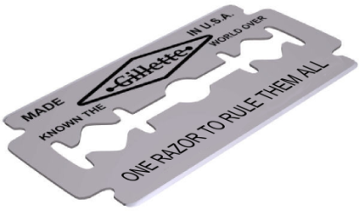
Some Notes …
Rules can be easily extracted from the built tree.
(District = Rural) → (Outcome = Responded)
(District = Urban) AND (Previous Customer = Yes) → (Outcome = Nothing)
One dataset, many possible trees
Occam's Razor “如无必要，勿增实体”，即“简单有效原理”。
The term razor refers to the act of shaving away unnecessary assumptions to get to the simplest explanation.
“When you have two competing theories that make exactly the same predictions, the simpler one is the better.”
“The explanation of any phenomenon should make as few assumptions as possible, eliminating those making no difference in the observable predictions of the explanatory hypothesis or theory.”
Simpler trees are generally preferred.
Notes:
多颗树
提取规则， if-then
规则可以写出来
奥卡姆剃刀 地心说 日心说
“最” 性价比最高的

Slide 38
ID3
How to build a shortest tree from a dataset?
Iterative Dichotomizer 3
Ross Quinlan: http://www.rulequest.com/
One of the most influential Decision Trees models
Top-down, greedy search through the space of possible decision trees
Since we want to construct short trees …
It is better to put certain attributes higher up the tree.
Some attributes split the data more purely than others.
Their values correspond more consistently with the class labels.
Need to have some sort of measure to compare candidate attributes.
Notes:
没有最优解，只能是启发式方法
最短的树
dichotomizer
n.两分器;

Slide 39
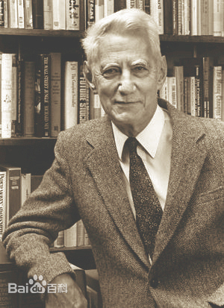
Entropy
p_{i}: the proportion of instances in the dataset that take the i ^{th} target value
S_{v}: the subset of S where attribute A takes the value v.
Claude Elwood Shannon
Notes:
信息熵 不确定性，最大值是1，二分类0.5 0.5的情况
最小值0，都是一个类别
信息增益
Gini基尼系数
克劳德·艾尔伍德·香农（Claude Elwood Shannon ，1916年4月30日—2001年2月24日）是美国数学家、信息论的创始人。1936年获得密歇根大学学士学位 ^{[1]} 。1940年在麻省理工学院获得硕士和博士学位，1941年进入贝尔实验室工作。香农提出了信息熵的概念，为信息论和数字通信奠定了基础。

Slide 40


Attribute Selection
$$Gain\left(S, District\right)=Entropy\left(S\right)−\frac{5}{14}Entropy\left(S_{District=Suburban}\right)$$
$$−\frac{5}{14}Entropy\left(S_{District=Urban}\right)−\frac{4}{14}Entropy\left(S_{District=Rural}\right)$$
$$=0.940−\frac{5}{14}∙0.971−\frac{5}{14}∙0.971−\frac{4}{14}∙0=0.247$$
$$Gain\left(S, Income\right)=Entropy\left(S\right)−\frac{7}{14}Entropy\left(S_{Income=High}\right)$$
$$−\frac{7}{14}Entropy\left(S_{Income=Low}\right)$$
$$=0.940−\frac{7}{14}∙0.9852−\frac{7}{14}∙0.5917=0.152$$
Notes:
地段
收入

Slide 41
Continuous Attributes
Samples are sorted based on Temperature.
Temperature | 40 | 48 | 60 | 72 | 80 | 90
Play Tennis | No | No | Yes | Yes | Yes | No
Threshold A
Threshold B
Notes:
连续值，离散化
阈值 选择

Slide 42
Entropy Bias
The entropy measure guides the entire tree building process.
There is a natural bias that favours attributes with many values.
Consider the attribute “Birth Date”
Separate the training data into very small subsets.
Very high information gain
A very poor predicator of the target function over unseen instances.
Such attributes need to be penalized!
Notes:
生日做为属性，分类分得最开
学生证号，身份证做为属性，分类分得最开
分得特别碎
越细越大

Slide 43
ID3 Framework
ID3(Examples, Target_attribute, Attributes)
Create a Root node for the tree.
If Examples have the same target attribute T, return Root with label=T.
If Attributes is empty, return Root with label=the most common value of Target_attribute in Examples.
A ← the attribute from Attributes that best classifies Examples.
The decision attribute for Root ← A.
For each possible value v_{i} of A
Add a new tree branch below Root, corresponding to A= v_{i}.
Let Examples (v_{i}) be the subset of Examples that have value v_{i} for A.
If Examples (v_{i}) is empty
Below this new branch add a leaf node with label=the most common value of Target_attribute in Examples.
Else below this new branch add the subtree
ID3(Examples(v_{i}), Target_attribute, Attributes-{A})
Return Root
Notes:
递归结构
挑选属性，对当前数据集，分类最好
属性进行排序，按照信息增益从大到小，选最大的
属性，只能用一次

Slide 44
ID3 Framework
{♠♠♠♠♠♠♠♠♠♣♣♣♣}
A₁
{♠♠♠}
{♠♠♠♠♠♠♣♣♣♣}
A₂
3 : 0
Pure node, stop!
Empty node, stop!
1 : 3
5 : 1
0 : 0
No more attributes, stop!
Decision Nodes
Leaf Nodes
Notes:
只有两个属性

Slide 45

ID3 例子

Slide 46


ID3 例子

Slide 47

ID3 例子

Slide 48

ID3 例子

Slide 49

ID3 例子

Slide 50

ID3 例子

Slide 51

ID3 例子

Slide 52

ID3 例子

Slide 53

ID3 例子

Slide 54

ID3 例子

Slide 55

ID3 例子

Slide 56

ID3 例子

Slide 57

ID3 例子

Slide 58

ID3 例子

Slide 59

ID3 例子

Slide 60


Slide 61


Slide 62
Overfitting
It is possible to create a separate rule for each training sample.
Perfect Training Accuracy vs. Overfitting
Random Noise, Insufficient Samples
We want to capture the general underlying functions or trends.
Definition
Given a hypothesis space H, a hypothesis h ∈ H is said to overfit the training data if there exists some alternative hypothesis h' ∈ H, such as h has smaller error than h' over the training samples, but h' has a smaller error than h over the entire distribution of instances.
Solutions
Stop growing the tree earlier.
Allow the tree to overfit the data and then post-prune the tree.
Notes:
训练 测试
现实，高分低能
后处理 剪枝

Slide 63

Pruning
Training Set
Validation Set
Test Set
9 : 5
Decision Nodes
Leaf Nodes
1 : 3
8 : 2
Notes:
不能无止境剪枝
T 叶子节点个数

Slide 64

Notes:
正则项

Slide 65


